Slide 1
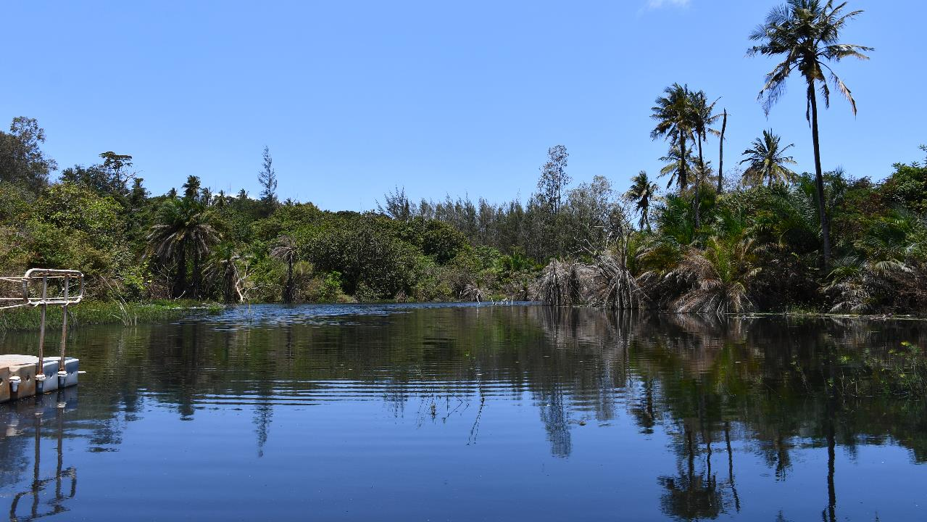

Effective Rehabilitation and Closure Planning
Lessons from Base Titanium, Kenya
Denham Vickers, General Manager Operations
Base Titanium Limited, Kenya
We are an environmentally responsible Mining Company, committed to restoring disturbed land to better than we found it for sustainable Post Mining Land Use
Image - Rehabilitated Silt Trap

Slide 2
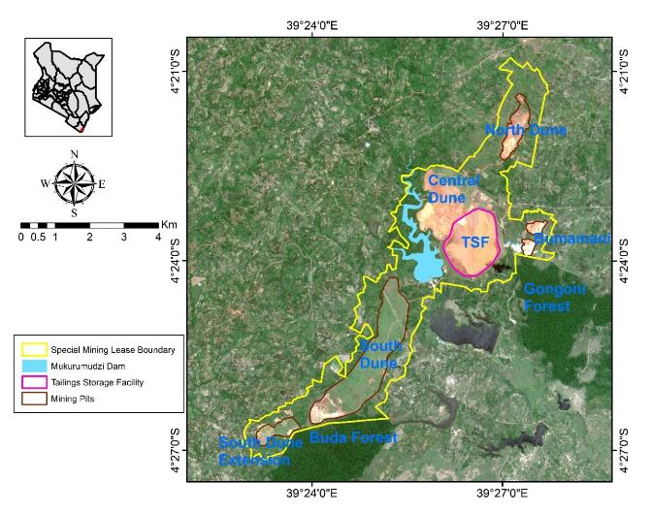
Context
Wholly owned subsidiary of Energy Fuels, USA
Commenced mining in Oct 2013
Kenya’s largest mine (75% of mineral exports)
1,200 employees
Mining rate 17Mt/Annum
Produced ilmenite, rutile and zircon
2,500Ha Special Mining Lease
1,100 Hectares disturbed; 100% rehabilitated
Mining ended in Dec 2024 – ore reserve depleted
Currently deconstructing processing plant for export
45Mt Tailings Storage Facility
Abuts 2 National Forest Reserves (Remnants of Coastal Forest Belt)
Project to date rehabilitation and restoration expenditure of $36m or KSh4,6 billion
CESMECC Webinar Feb 2026

Slide 3
Context – Kwale Performance
Kwale Project Key Indicators - 2012 to 2026
PRODUCTION | UNITS | PROJECT | FINANCIALS | UNITS | PROJECT
Tonnes mined | t | 153,507,249 | Construction capex | $ '000 | 352,908
Mining rate | tph | 1,804 | Ongoing capex | $ '000 | 118,673
Heavy Mineral Grade | % | 5.18 | Operating costs | $ '000 | 704,355
Ilmenite | t | 3,890,911 | Royalities paid | $ '000 | 100,802
Rutile | t | 807,896 | Corporate tax paid | $ '000 | 92,606
Zircon | t | 295,188 | TOTAL COSTS | $ '000 | 1,369,344
SERVICES |  |  | Health, Safety & Training
Major pipelines constructed | km | 58 | Total peak workforce | No. | 1,693
Powerlines constructed | km | 48 | Manhours worked | Hrs | 52,014,451
Dams constructed | No. | 21 | Fatalities | No. | -
Meals served | No. | 3,347,292 | Lost Time Injuries | No. | 5
 |  |  | Project Lost Time Frequency | /m hours | 0.096
REHABILITATION |  |  | Training hours delivered | Hrs | 869,863
Area rehabilitated | Ha | 1,050 | Apprentices trained | No. | 75
Total trees planted | No. | 1,060,702 | Graduates trained | No. | 42
CESMECC Webinar Feb 2026

Slide 4
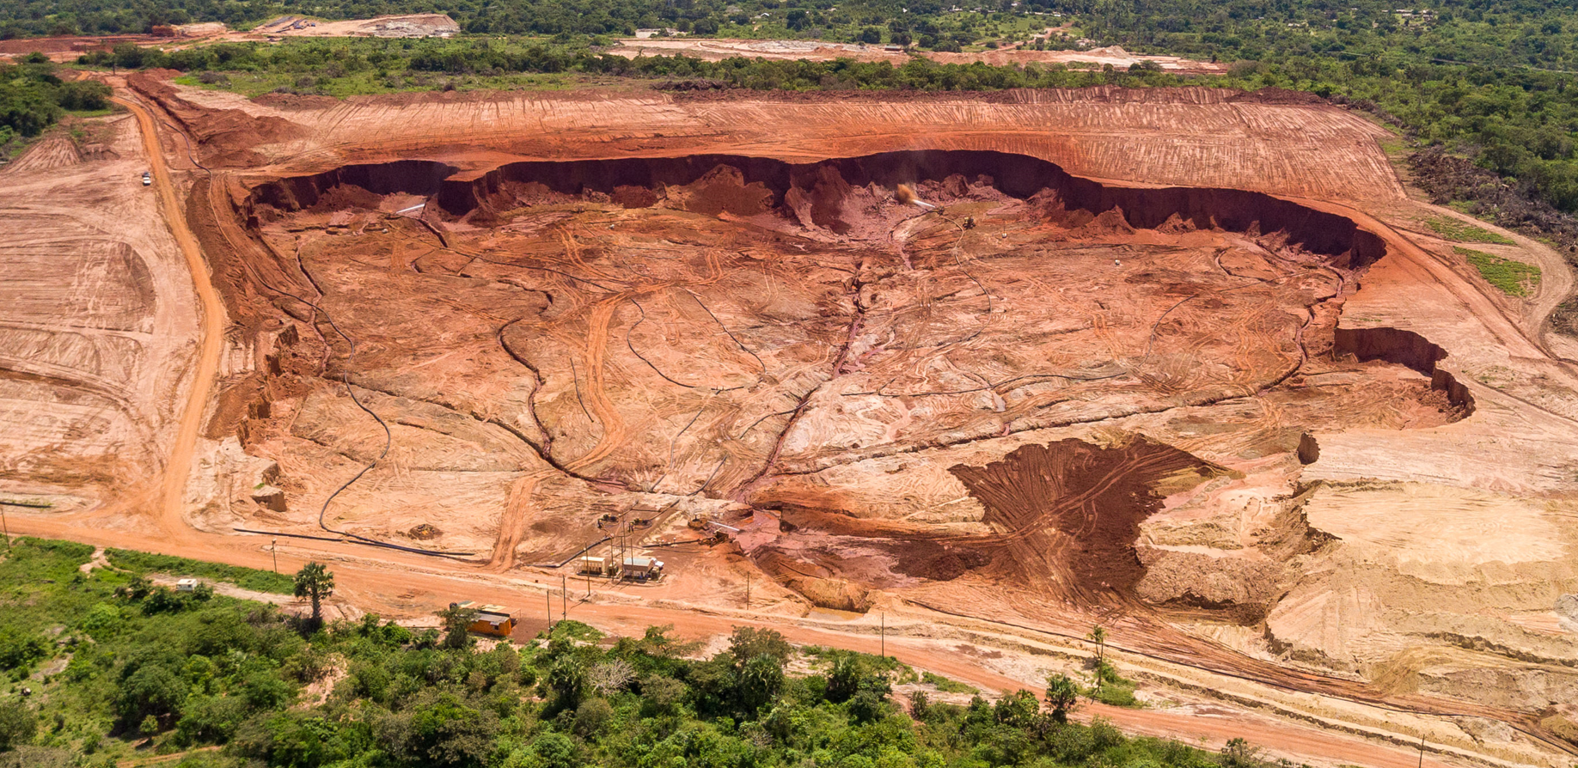
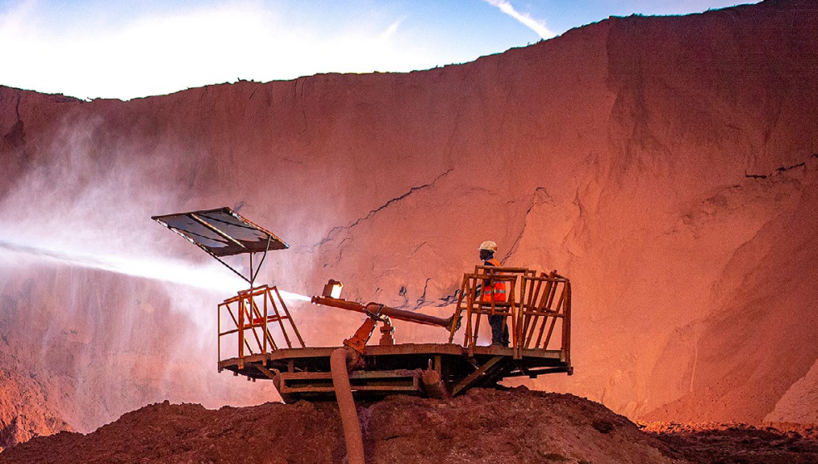
Operations
Hydraulic mining producing Ilmenite, Rutile and Zircon. Physical separation process – no chemicals used
CESMECC Webinar Feb 2026

Slide 5
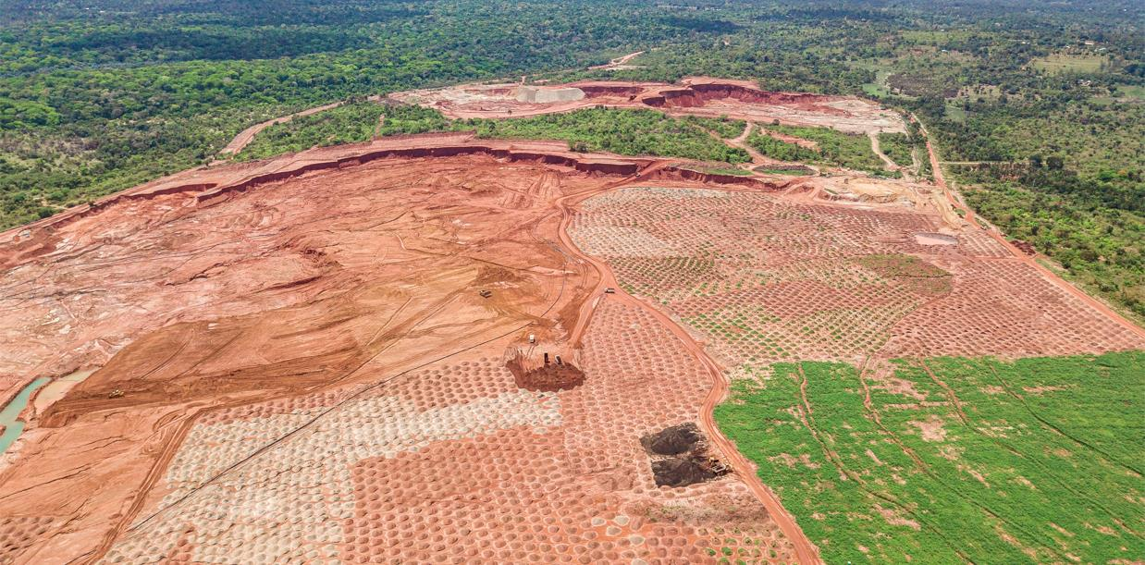
Rehabilitation
Concurrent rehabilitation
Active mining
300m buffer zone
Mining completed
Topsoil + Sun Hemp
Profiling
Manure
Newly rehabilitated terrain
1 month post seeding and irrigation
CESMECC Webinar Feb 2026

Slide 6
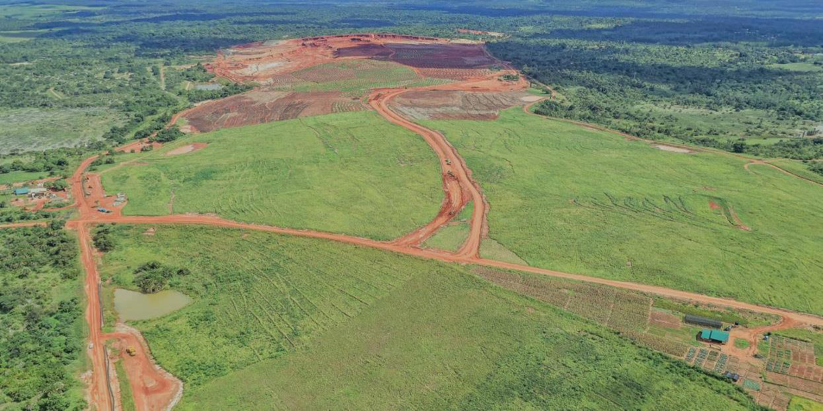
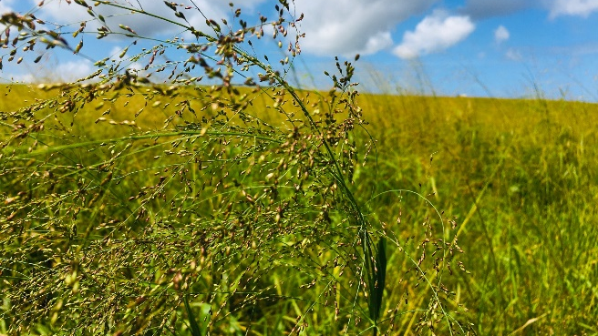
Rehabilitation
Rehabilitation is costly and must be considered as part of normal operations – not an add-on
Rehabilitation Costs | US$ / Ha
Central Dune with Co-Disposal | 87,000
South Dune no Mix | 25,000
Biodiversity Corridor
Restored wetland
Agricultural trials
CESMECC Webinar Feb 2026

Slide 7
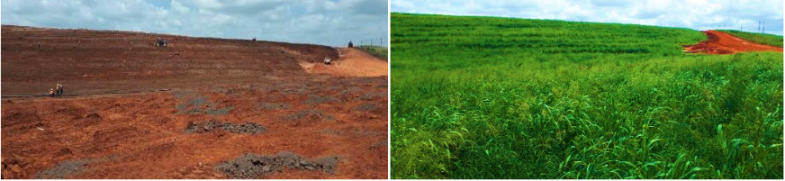
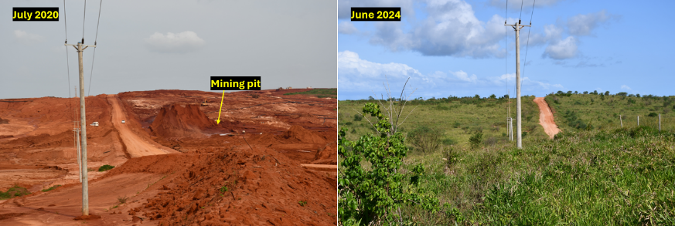
Rehabilitation
With time and adequate investment, successful rehabilitation is possible
Dec 2021
Jun 2022
CESMECC Webinar Feb 2026

Slide 8
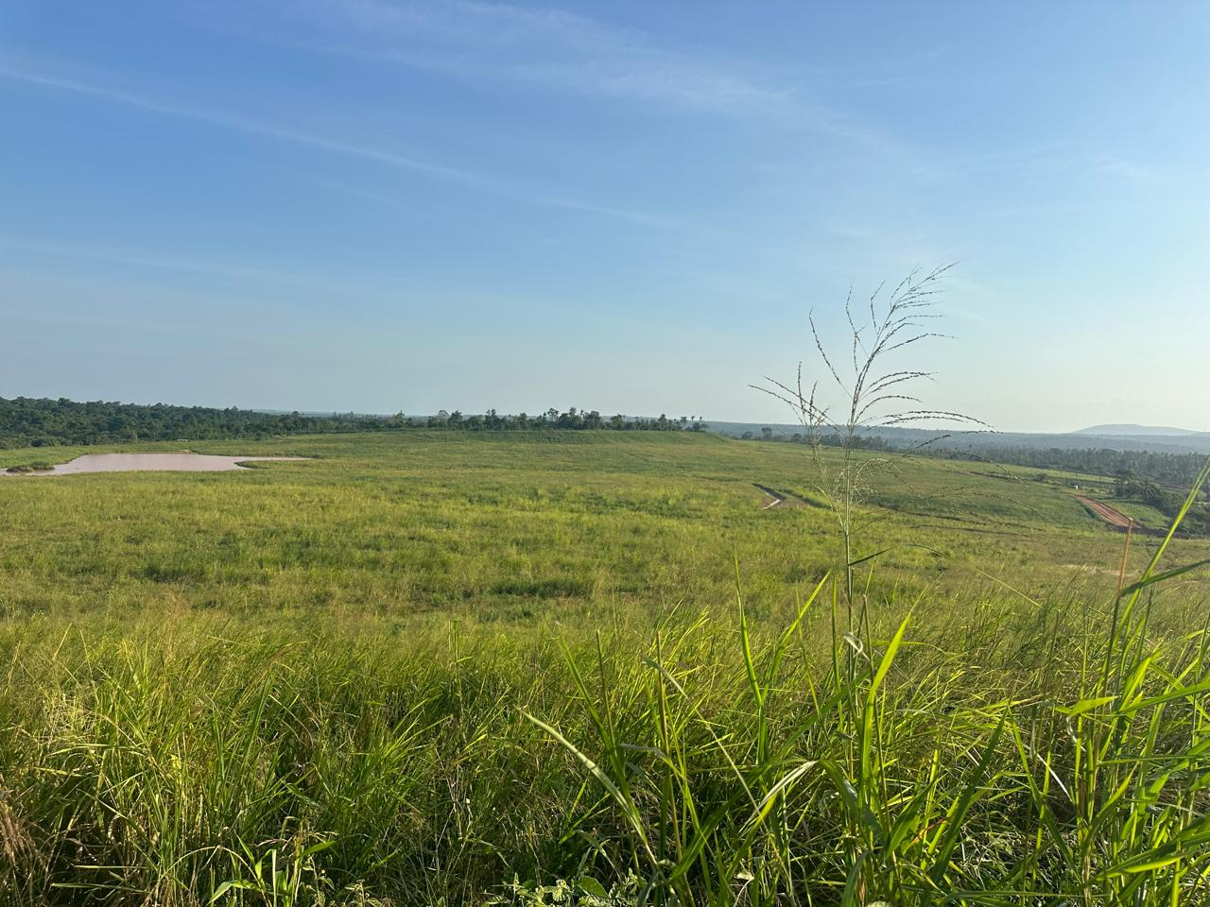
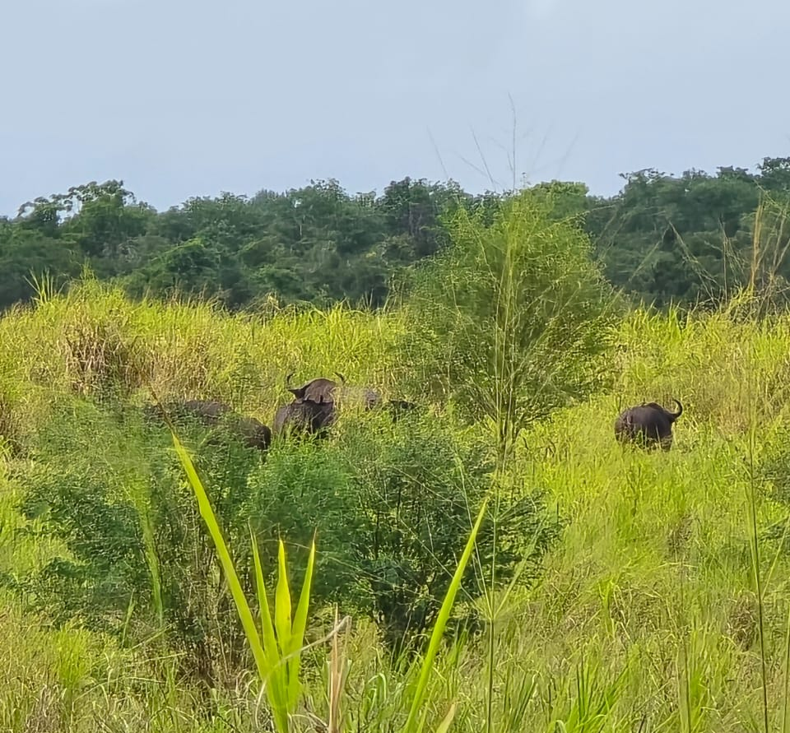
Restoration – South Dune
With adequate time, progression to a fully functioning ecosystem is achievable
CESMECC Webinar Feb 2026

Slide 9
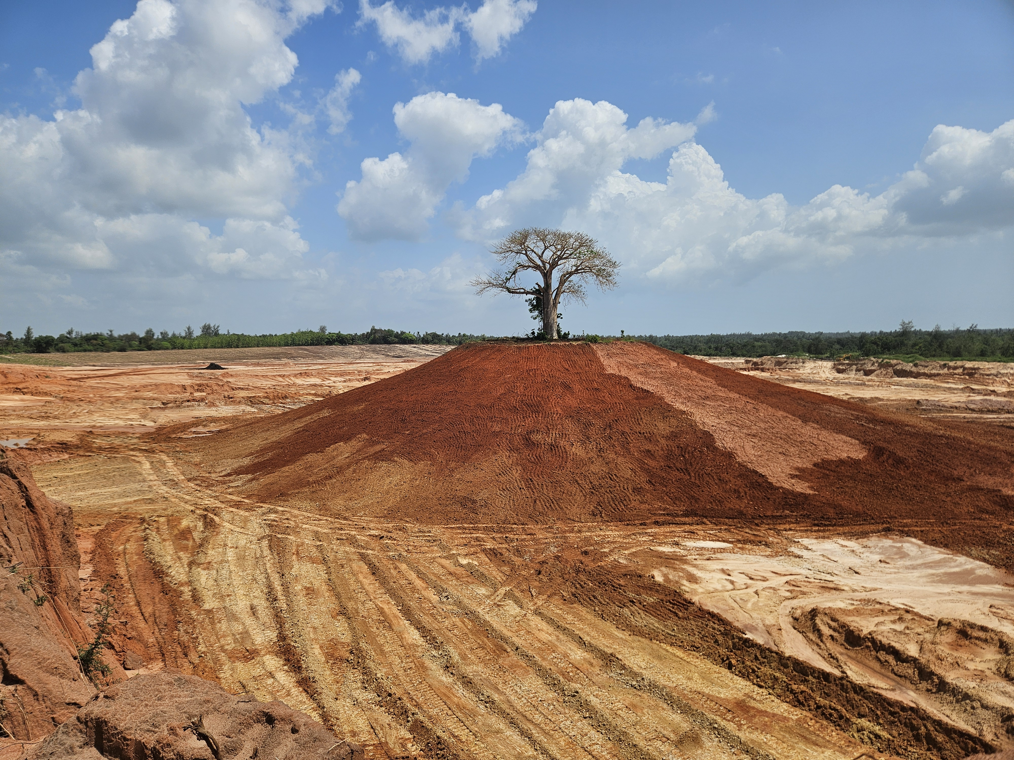
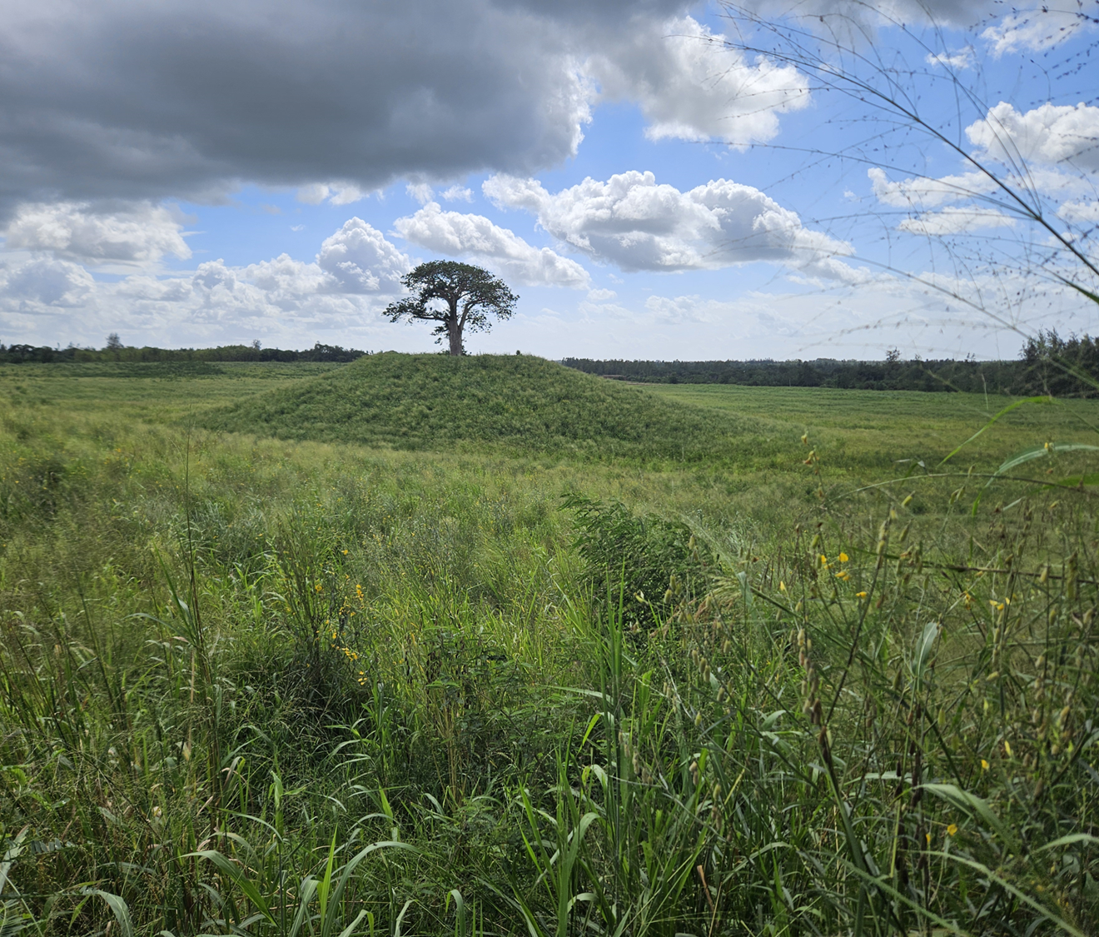
Restoration - Bumamani
30 December 2024
30 December 2025
CESMECC Webinar Feb 2026

Slide 10
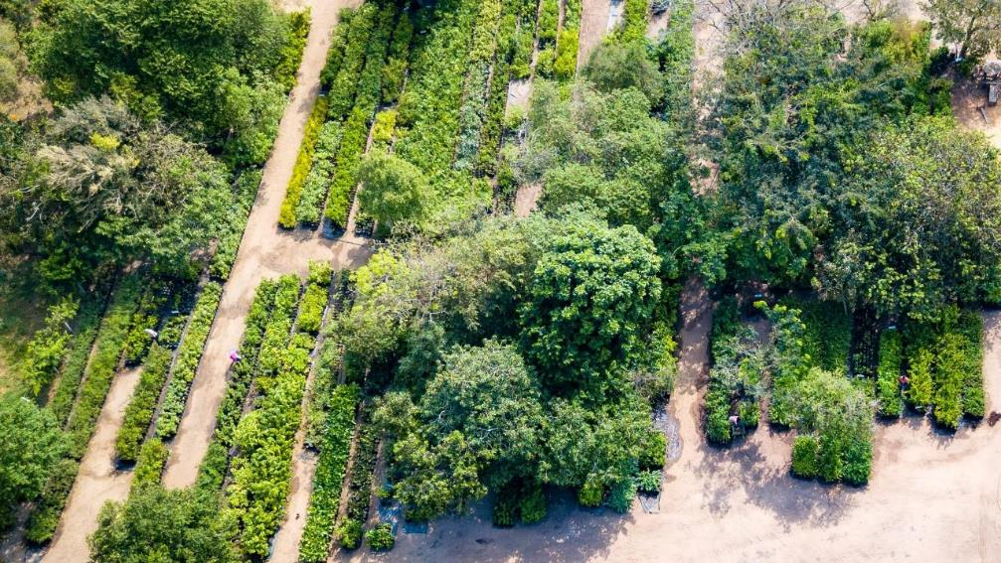
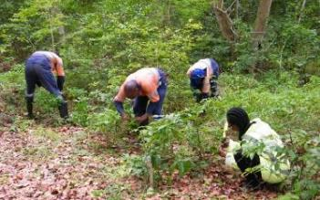
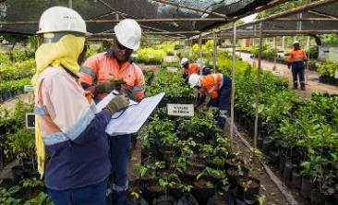
Restoration – Indigenous Nursery
The nursery provides tree seedlings for rehabilitation and restoration. Seed stocks are obtained from surrounding forests
307 indigenous species
Over 50,000 seedlings in stock
800,000 indigenous trees planted including the following Critically Endangered species:-
Uvaria puguensis
Gigasiphon macrosiphon
Euphorbia Tanaensis
Cola porphyrantha
Pavetta tarennoides
Vangueriopsis shimbaensis
260,000 Eucalypts planted
18
CESMECC Webinar Feb 2026

Slide 11
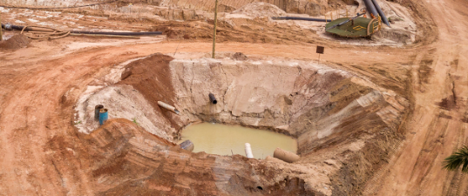
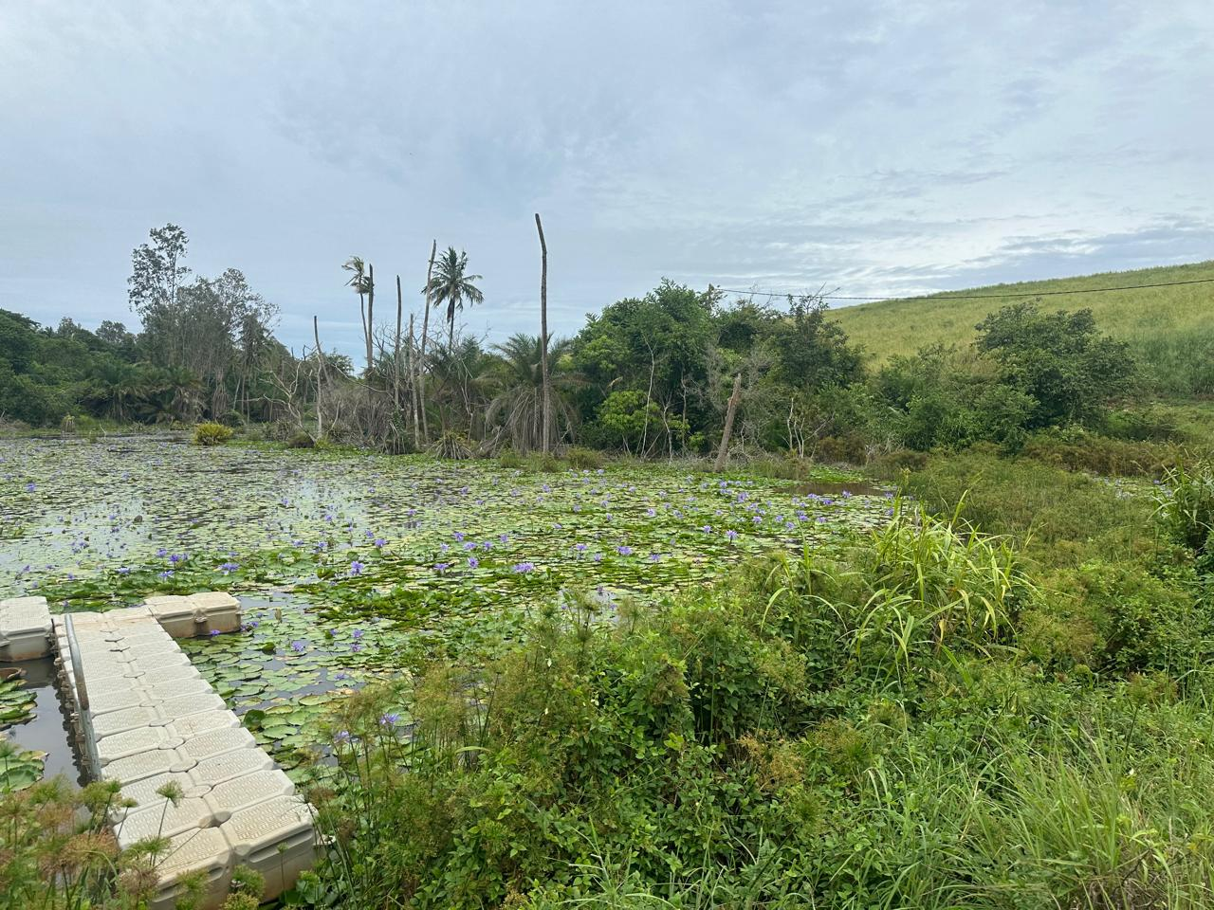
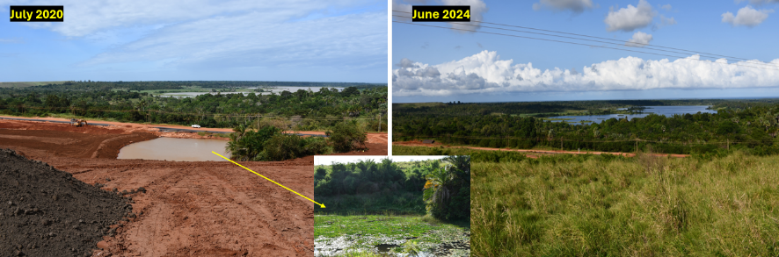
Created Wetlands
21 wetlands have been created from mine voids and silt traps. These are fully functional with diverse flora and fauna species
CESMECC Webinar Feb 2026

Slide 12
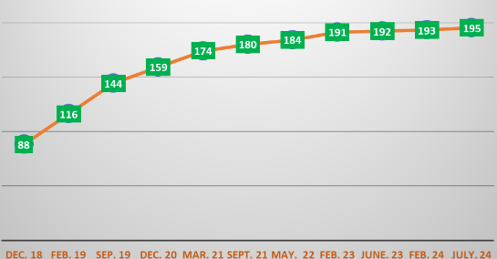
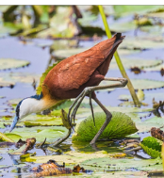
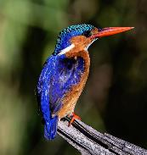
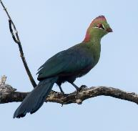
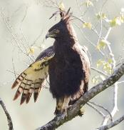
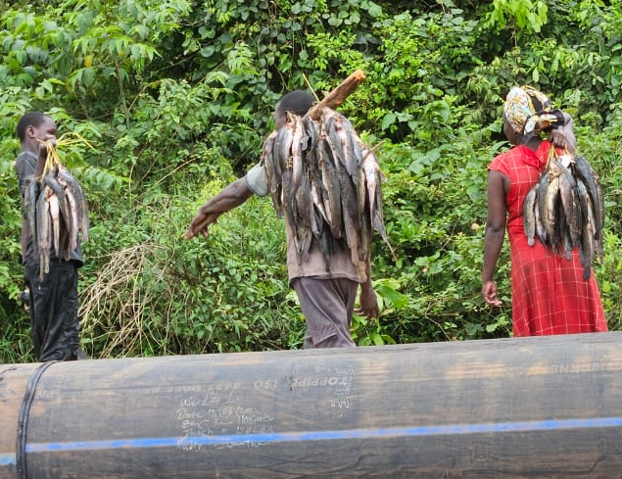
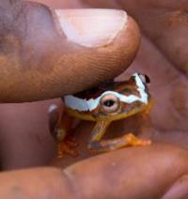
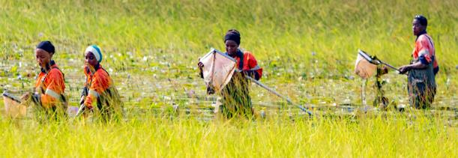
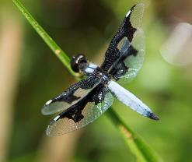
Created Wetlands
198 bird species have been recorded including 23 of conservation concern
African Jacana
Malachite Kingfisher
Fischer's Turaco
Long crested Eagle
Fish from Wetland
Shimba Hills Reed Frog
Monitoring of aquatic micro invertebrates in wetlands
CESMECC Webinar Feb 2026

Slide 13


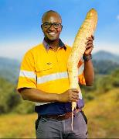


Co-disposal of Tailings for Rehabilitation
Sand tails were disposed in the mined-out area of Central and North Dunes. In order to allow vegetation to grow, a co-disposed mix layer is placed up to 6m thick on top of the sand to form a moisture retention layer.
6.2kg Cassava
1. Pre-mining
Sand/mix deposition
2. Mining
Mining void
Topsoil (0.3m)
Mix (Sand & Slime) (2-6m)
Mix (sand & slime)
3. Rehabilitation
Sand Tails (~30m)
Sand Tails
4. Post Mining
Planting (with manure + fertilizer)
CESMECC Webinar Feb 2026

Slide 14
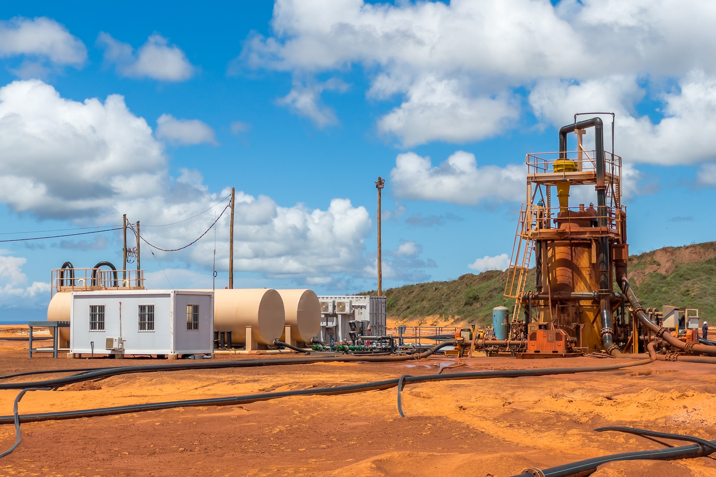
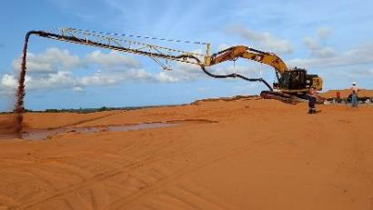
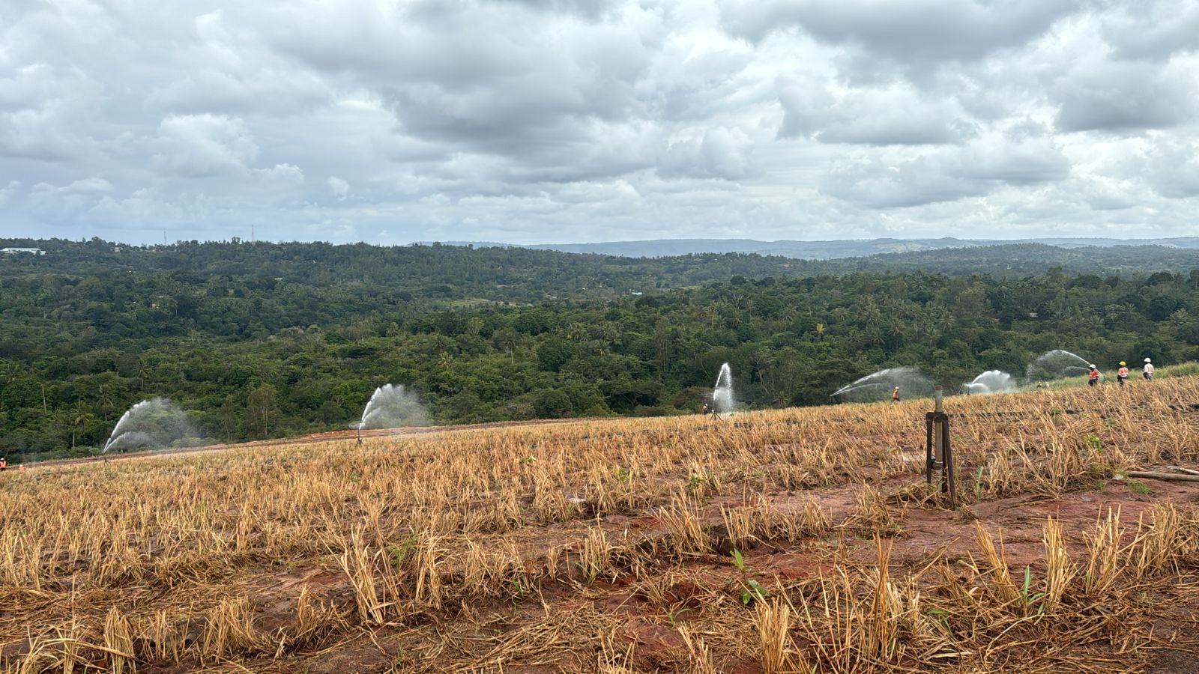
Co-disposal of Tailings for Rehabilitation
A tailings mix plant was designed and built to reconstitute coarse and fine tailings at a 75% : 25% ratio with the addition of flocculant.
RehabilitationMix Plant
Mix Deposition
Mix Rehab Planting
CESMECC Webinar Feb 2026

Slide 15
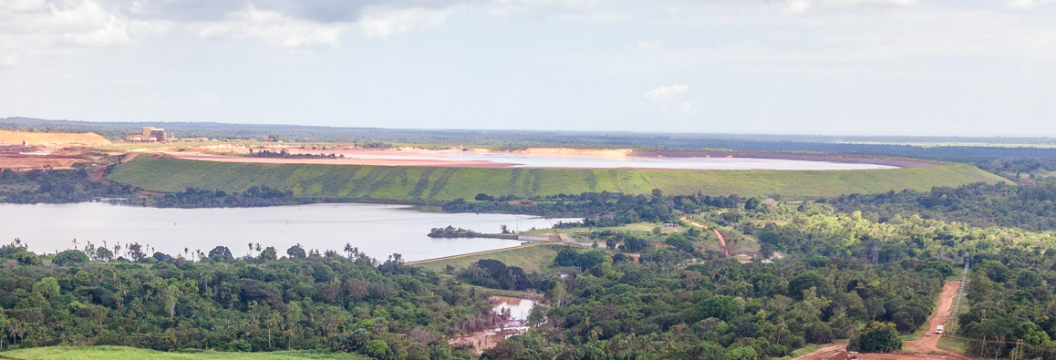
Tailings Facility Closure
270 Ha Tailings Storage Facility containing 45Mt of fine slimes impounded within a sand tailings embankment. Closure spillway construction location pending slimes settlement evaluation.
CESMECC Webinar Feb 2026

Slide 16
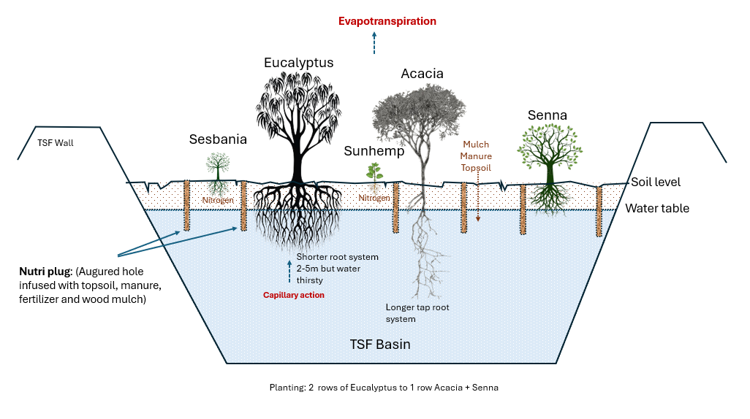
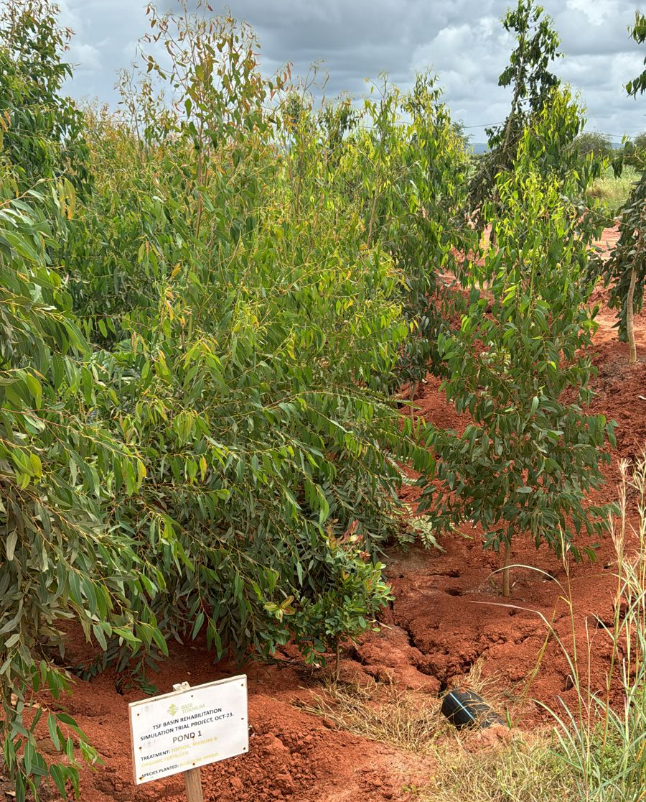
TSF Closure
TSF closure will be achieved by planting 260,000 Eucalypts, Acacias and Senna to remove moisture and stabilise slimes. Nutrition achieved by planting with topsoil/manure mix and introduction of Sunhemp. Planting was completed in Jan 2026, 1 year ahead of schedule.
Eucalyptus trials in slimes pit
CESMECC Webinar Feb 2026

Slide 17
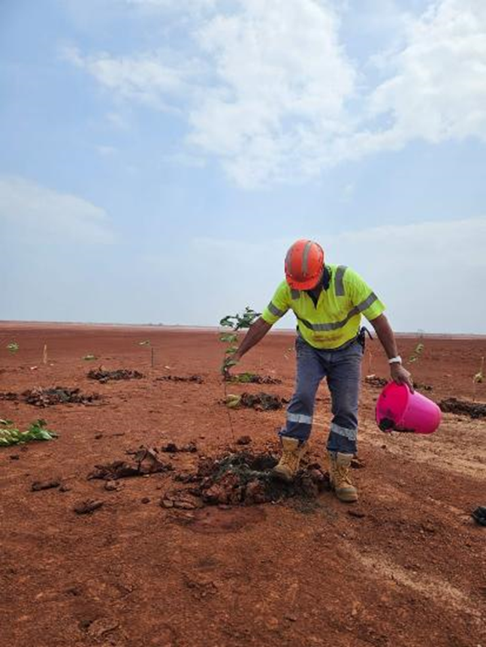
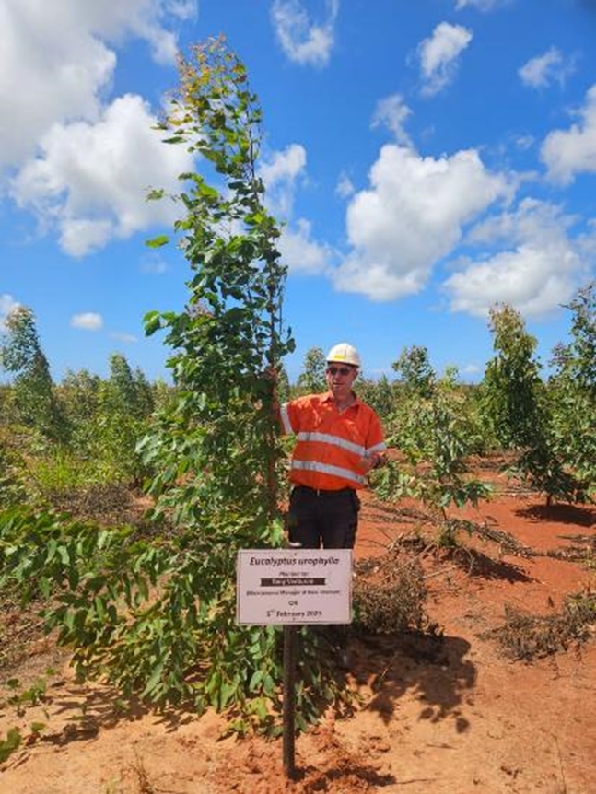
TSF Closure - Rehabilitation
Commencement of TSF rehabilitation in February 2025
TSF Tree growth as of July 2025
CESMECC Webinar Feb 2026

Slide 18

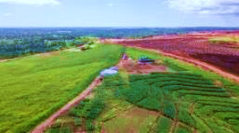
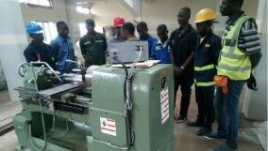

Post Mining Land Use (PMLU)
PMLU was developed through research, trials and stakeholder engagement. Numerous concepts were evaluated and screened down to three outcomes
Conservation
Screen 1: Research & criteria-based
Screen 2: Field trials
Brainstorm/
Blue Sky
Recommendation to Govt led PMLU Committee
Agribusiness
Concept Report
PFS Report
DFS Report
Training
Criteria:
Asset utilisation (water, power, land capability)
Benefit to community
Alignment to local & national agenda (environmentally, socially and economically)
Trials:
1. Agribusiness
2. Wildlife suitability & Community acceptance
3. Training needs research
Stakeholder Engagement (Internal & External)
CESMECC Webinar Feb 2026
Notes:
A well defined PMLU aids in the definition of closure vision, objectives, activities and success criteria. Our PMLU followed a defined process. I

Slide 19
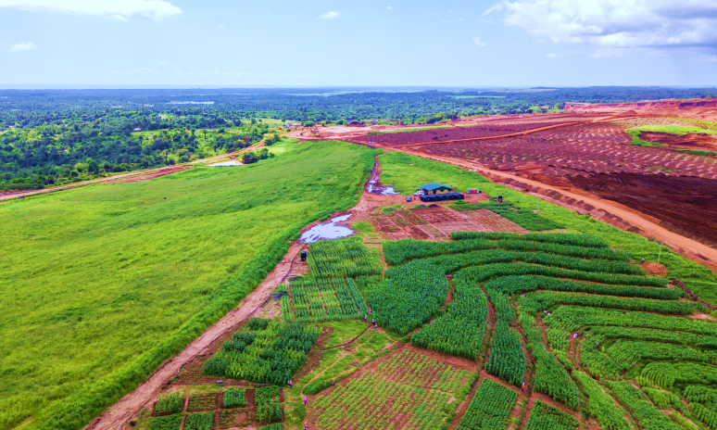
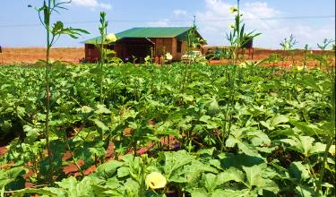
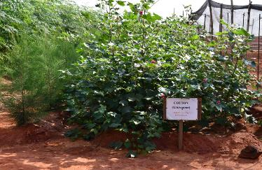
PMLU Trials
Agribusiness trials included maize, cassava, ginger, cotton, mango, cashew, citrus, sugar, moringa, papaya, banana
CESMECC Webinar Feb 2026

Slide 20
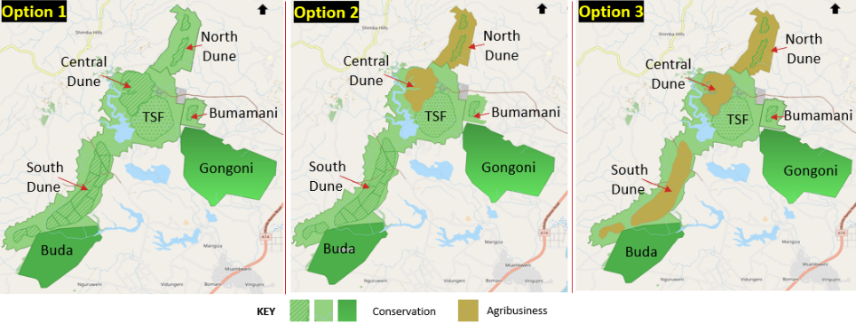
PMLU Outcome
The three themes were combined as shown in the map below
Three PMLU Themes
Conservation: Create a 3,700 Ha Conservancy area by merging South Dune and Bumamani with Gongoni and Buda Forests.
Agribusiness: Create approximately 500Ha suitable for Agribusiness upon satisfactory relinquishment.
Training: Utilise workshops, office buildings and camp and convert to technical training facility
CESMECC Webinar Feb 2026

Slide 21
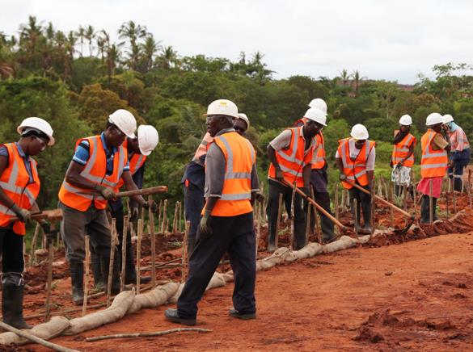
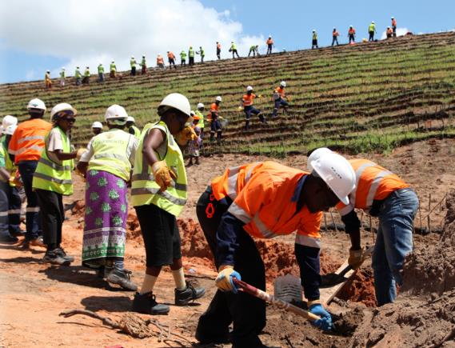
Community and Stakeholder Engagement
Over 75% of our employees are from the surrounding community and villages. A social license is critical to successful operations
Page 21
CESMECC Webinar Feb 2026

Slide 22
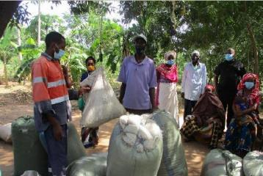
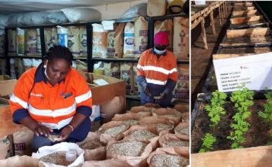
Community and Stakeholder Engagement
Grass and legume seeds are sourced from the neighbouring community creating employment. Close to $0.5M has been spent on seeds comprising 20 different species.
Grass / legume seeds from community
Seeds QC / Storage / Mixing
CESMECC Webinar Feb 2026

Slide 23
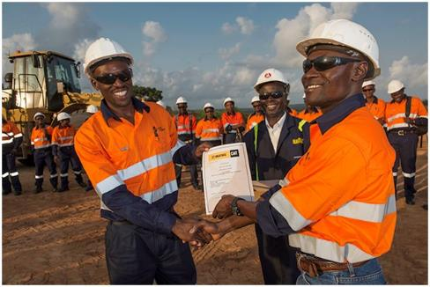
Employee Closure Transition Preparation
A practical learning environment for rapid transfer of skills
No mining skills were available in Kenya at onset
Fast-track programme to develop talent for senior roles
Graduate & Internship programs
Apprenticeship programs
Technical Training programs for community members
High School Scholarships for technical courses
Partnering with GoK to develop a Recognition of Prior Learning program providing formal qualifications for skills developed at Base
Life After Mine programme to prepare employees for closure. Financial management, tooling, CV database, counselling etc.
Base Titanium employees now accessing opportunities both nationally and overseas as expatriates
CESMECC Webinar Feb 2026

Slide 24
Conclusion
While these are lessons from Base Titanium, closure is often site specific. Success, therefore, depends on several factors:
Topsoil is gold – remove and stockpile for future rehabilitation
PMLU must be understood to guide rehabilitation and closure planning
Rehabilitation must be concurrent to avoid major costs after cashflow ends
Technical research is critical to achieving sustainable closure
Stakeholder participation is critical for effective closure, acceptance and sustainability of PMLU
Employees are our key assets and must be prepared for closure and Life After Mine
CESMECC Webinar Feb 2026

