Slide 1
The Global Imperative for a Circular Economy —
and Why it Matters for Africa’s Mining Sector
SDG 12 & SDG 7
Materials Science & Engineering
Decarbonisation (incl. SAF)
Regenerative Life‑Support Systems
Africa’s Key Minerals
AMV & Governance
Dr.-Ing. Nashon J. Adero nashon.adero@ttu.ac.ke
Dean, School of Mines & Engineering (TTU)
KCM Executive Board Representative for professionals & academia
National Representative, International Society for Mine Surveying (ISM)
Founder, Impact Borderless Digital

Slide 2
Why Circularity, Why Now?
Linear “take‑make‑waste” models clash with finite resources and climate limits
SDG 12 (Responsible Consumption & Production) + SDG 7 (Affordable & Clean Energy) frame the mandate
Circularity is a competitiveness strategy: resilience, lower costs, and emissions reduction
For mining-led economies, circularity means value retention along the whole chain (vertical integration)
Notes:
Frame circularity as a design transformation, not just waste management.
Link SDGs to industrial strategy and investment flows.
Key message: circularity underpins productivity and risk management in volatile markets.

Slide 3
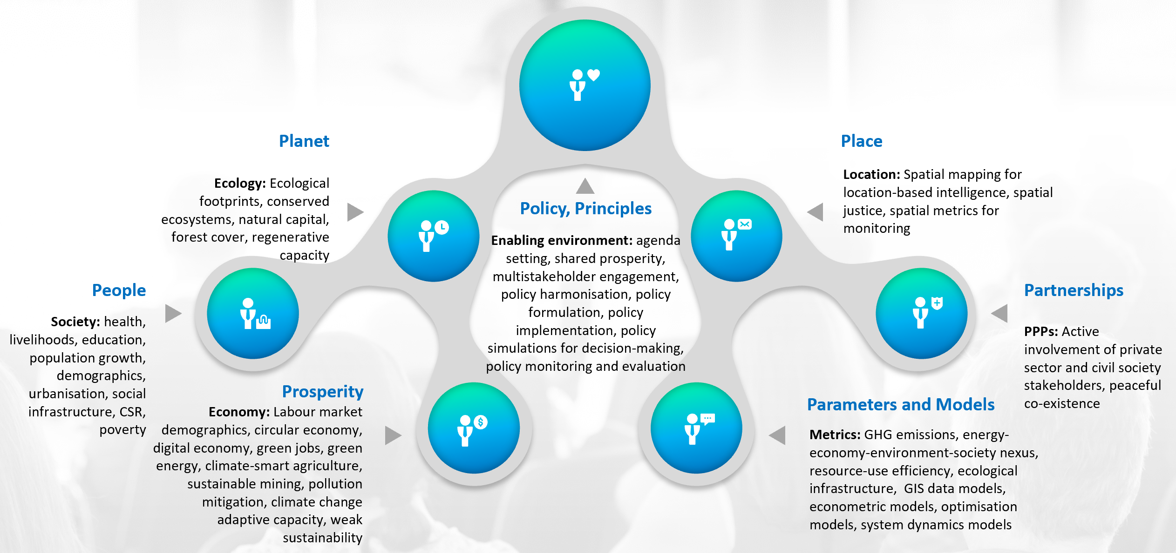
Synthesis of international discourse on sustainable mining from 30 international conferences attended by Nashon Adero (2017-2023)

Slide 4
From Linear to Circular: Principles and Planetary Boundaries
Eliminate waste and pollution by design
Keep products and materials in use (repair, reuse, remanufacture, recycle)
Regenerate nature — restore the life‑support systems industry depends on
Operate within ‘planetary boundaries’ to maintain a safe operating space for humanity
Notes:
Emphasise that regeneration is active restoration, not only footprint minimisation.
Planetary boundaries provide the urgency and science-based thresholds.

Slide 5
The Decarbonisation Imperative for Industry
Material efficiency + circular flows are essential to reach net‑zero industry
Pair process decarbonisation (electrification, renewables, fuel switching) with demand reduction
Policy levers: standards, carbon disclosure, green public procurement, demand‑side pull
Notes:
Stress that circularity and decarbonisation are complementary strategies, not substitutes.
Mention emerging demand signals for low‑carbon, circular materials.

Slide 6
Materials Science & Engineering — Engine of Circularity
Design for durability, repairability, modularity, remanufacture, and high‑quality recycling
Smart alloys, coatings, and joining methods enable multiple lifecycles and easy disassembly
Digital product passports & traceability solutions to track composition and provenance
Notes:
Engineering choices determine downstream circular outcomes decades later.
Highlight the role of standards and interoperable data.

Slide 7
Clean‑Energy Transitions are Mineral‑Intensive
Batteries: lithium, nickel, cobalt, manganese, graphite
Wind/EVs: rare‑earth magnets (e.g., Nd, Pr, Dy)
Grids & electrification: copper and aluminium in very large volumes
Implication: more mining and much more circularity — recovery, secondary supply, traceability/blockchain
Notes:
Underscore the scale effect: every net‑zero pathway increases materials demand.
Circular design and recycling ease pressure on primary extraction over time.

Slide 8
Africa’s Green‑Minerals Endowment and Value Addition
Examples: DRC (cobalt), Zambia/DRC (copper), South Africa (PGMs), Guinea (bauxite), etc.
Zimbabwe (lithium), Mozambique/Madagascar (graphite), Namibia (uranium/RE), others
Opportunity with conditions: environmental & social performance, skills, energy, logistics
Policy frames: African Mining Vision (AMV), African Green Minerals Strategy, AfCFTA for regional chains
Shift from raw exports to beneficiation, refining, and component manufacturing
Notes:
Position Africa as a partner in global decarbonisation with value capture at home.
Cite the importance of power reliability, water stewardship, and community benefits.

Slide 9
Making Mining Circular in Africa (Mine‑to‑Market)
Water‑energy‑materials integration in mine design; electrify and digitise operations
Re‑process tailings and waste rock; design for zero‑waste where feasible
Remanufacture heavy equipment; repair/refurbish spares to extend service life
Industrial symbiosis: use residues in cement, bricks, aggregates; co‑location strategies
Urban mining and recycled‑content standards to grow secondary supply locally
Notes:
Share one or two African case examples where tailings reprocessing created new value.
Stress skills development and local supplier ecosystems for remanufacturing.

Slide 10
Aviation and SAF: Decarbonising Long Supply Chains
Sustainable Aviation Fuel (SAF) offers significant lifecycle CO₂ reductions versus fossil jet fuel
Today’s volumes are small and costs higher; mandates and offtake agreements are scaling
Why it matters: trade, tourism, conferences — credible flight decarbonisation complements circularity
Signals: corporate travel policies and green logistics increasingly prioritise lower‑carbon options
Notes:
Acknowledge varying SAF impacts by feedstock/process; sustainability safeguards are critical.
Tie to mining’s scope 3 emissions and international investor expectations.

Slide 11

A 10‑Point Action Agenda (Governments • Miners • Financiers)
1) National circular‑economy & critical‑minerals strategies aligned with AMV/AGMS.
2) Design/engineering standards for durability, reuse, remanufacture, and recycling.
3) Green public procurement & minimum recycled‑content/product standards.
4) Digital traceability from pit to product (data transparency & certification).
5) Tailings valorisation & secondary‑materials markets with bankable pipelines.
6) Water‑energy‑materials integration in mine planning & operations.
7) Skills pipelines in materials science, systems modelling, and circular design.
8) Incentives for industrial symbiosis & local beneficiation under AfCFTA.
9) SAF/offtake partnerships for corporate travel & logistics where material.
10) Full transparency (e.g., EITI), contract disclosure, and community benefit agreements.
Notes:
Invite the audience to pick 2–3 actions to implement within 12 months.
Close with the message: circularity is a growth and resilience strategy for Africa’s mining future.

